Slide 1
BLOOD BANK MANAGEMENT SYSTEM
Group name: Cutting Chai
Group no: 3
Group member:
Sachin Manral
Smit Patil
Shravani Vaze

Slide 2
SUMMARY
The blood bank management system intends to simplify and automate the search process for blood in the event of an emergency and maintain records of blood donors, recipients, blood donation programs, and manage bloodstock inventory in the blood bank.

Slide 3
MISSION OBJECTIVES
To provide the blood bank with appropriate donor information
To maintain bloodstock management by recording donor information and blood data.
To provide a coordinated, centralized database of donors and bloodstocks.
To provide for immediate data and information storage and retrieval.

Slide 4
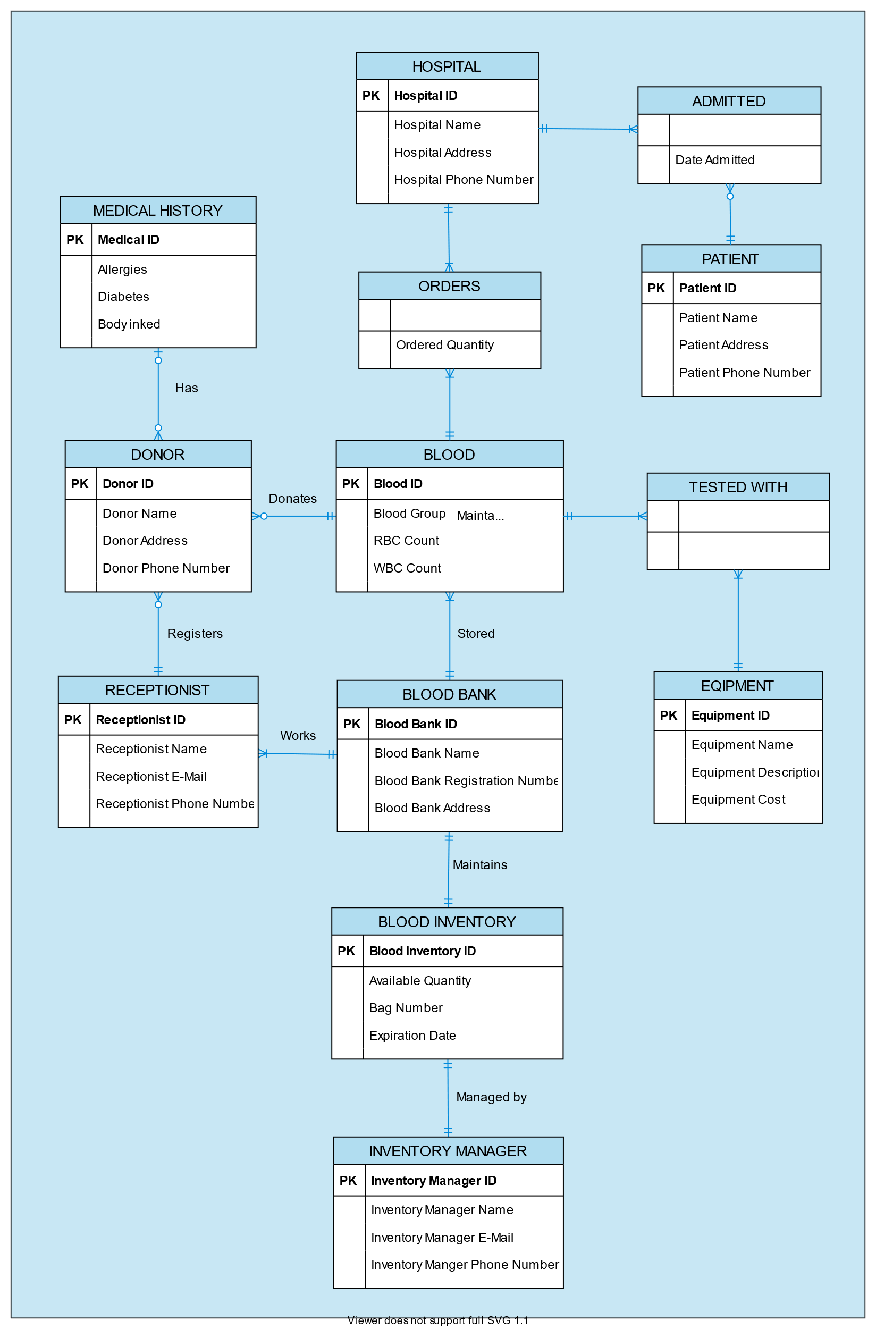
E-R Diagram:

Slide 5
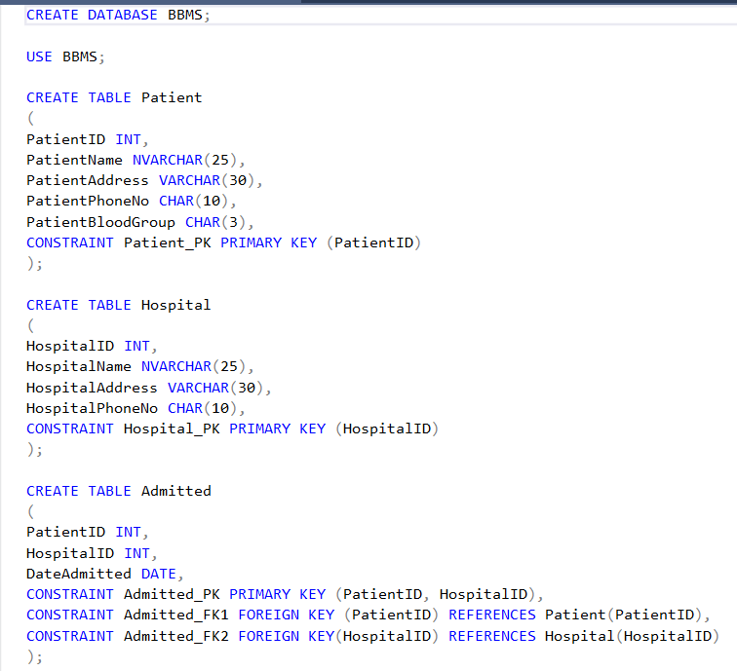
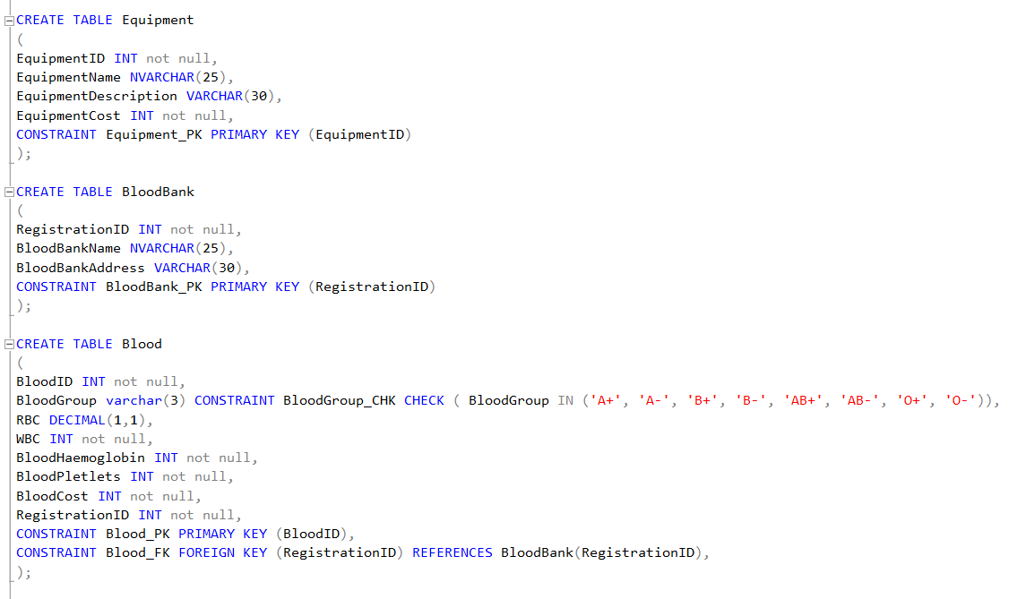
SQL DDL STATEMENTS:

Slide 6
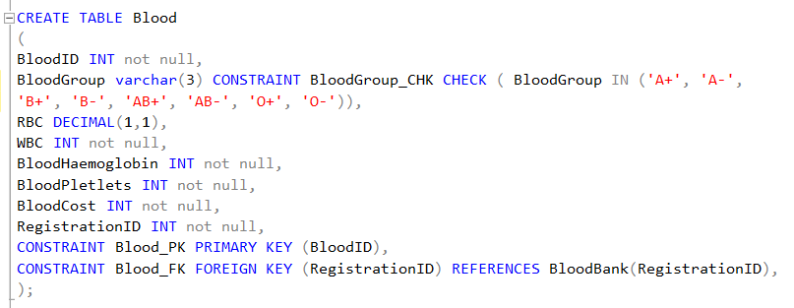
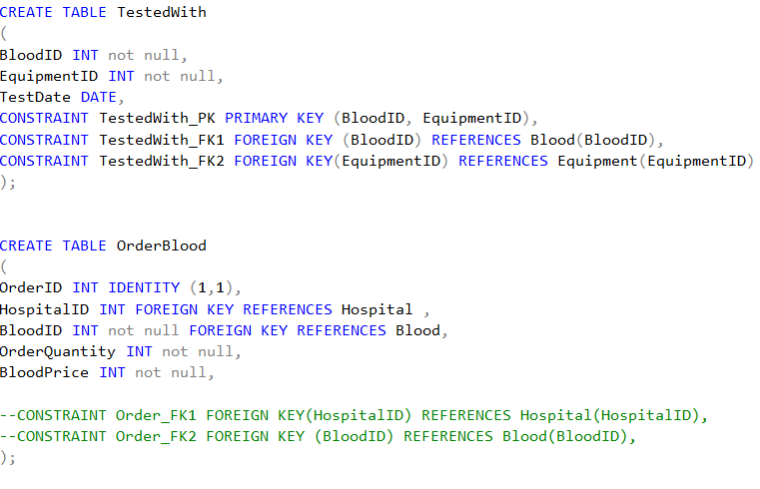
SQL DDL STATEMENTS:

Slide 7
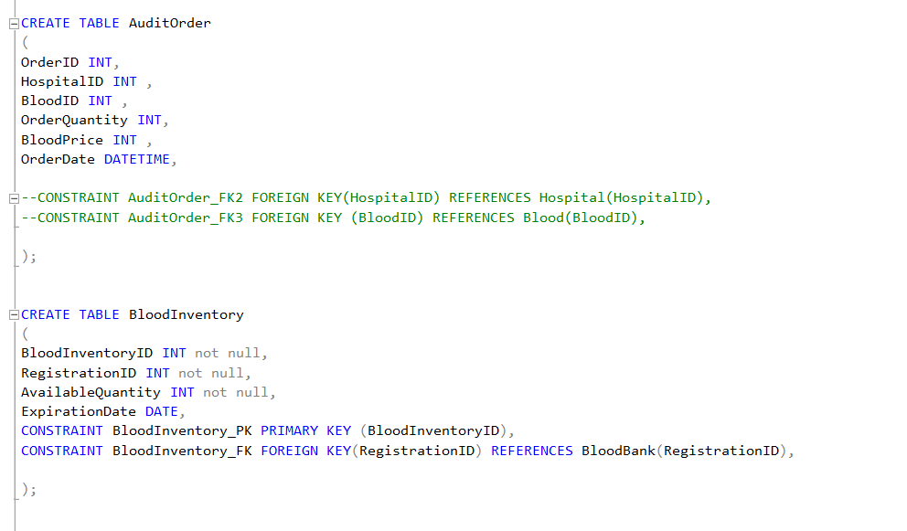
SQL DDL STATEMENTS:

Slide 8
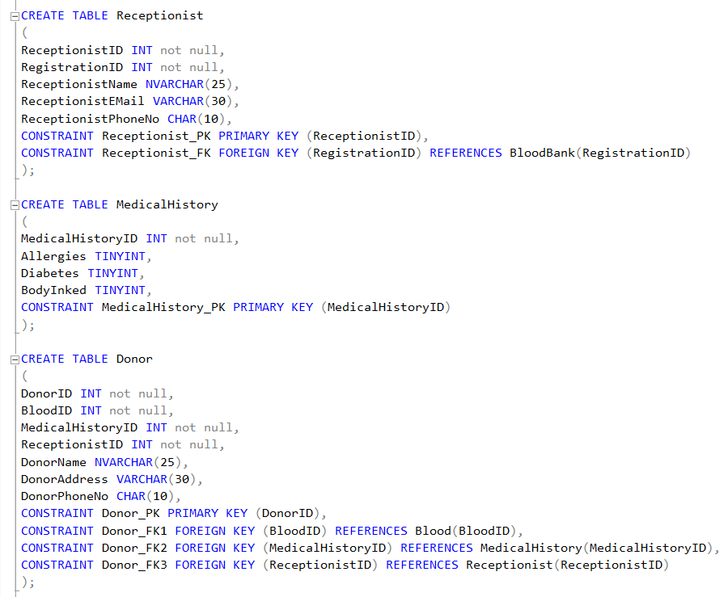
SQL DDL STATEMENTS:

Slide 9
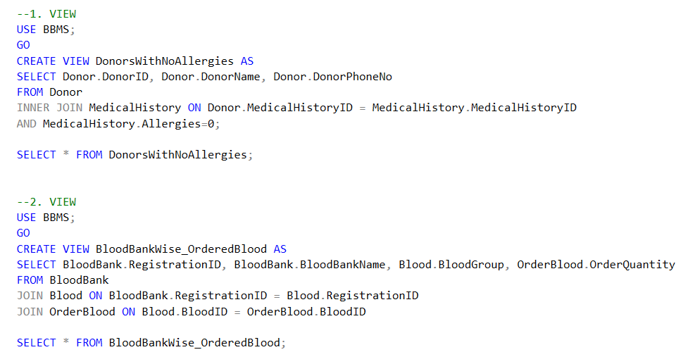
VIEWS

Slide 10
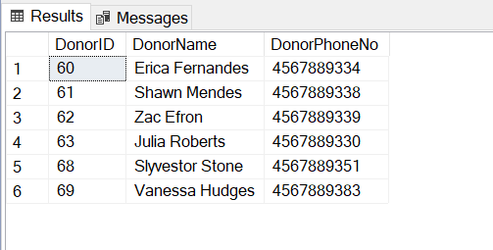
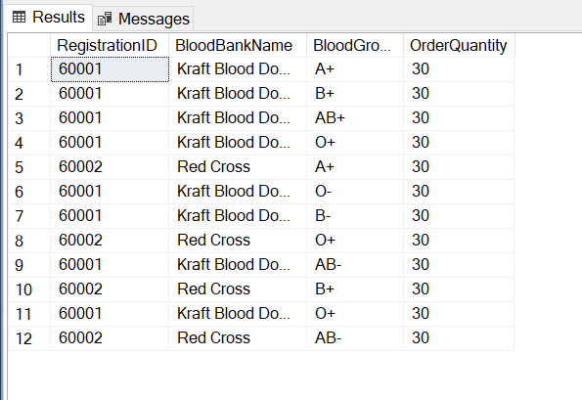
VIEWS OUTPUT:

Slide 11
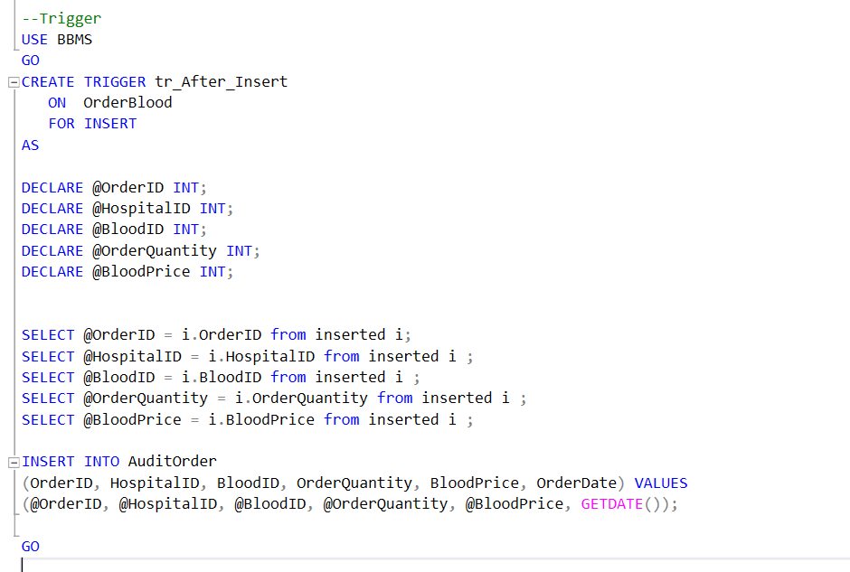
TRIGGERS

Slide 12
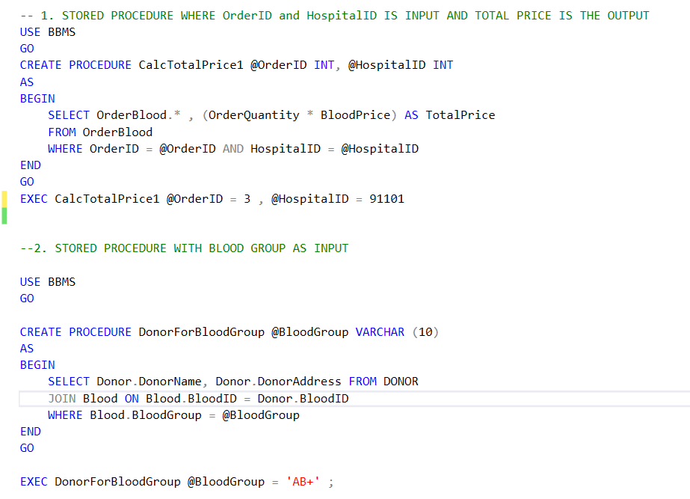
STORED PROCEDURE

Slide 13
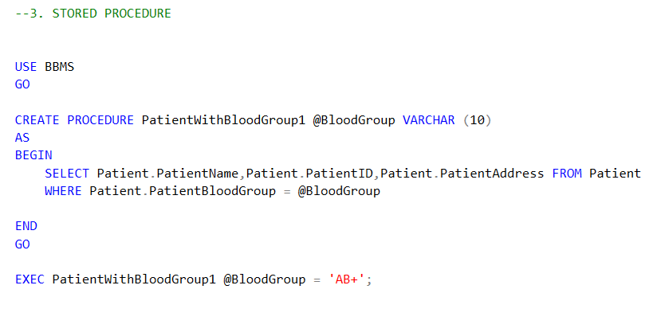
STORED PROCEDURE CONTINUED:

Slide 14
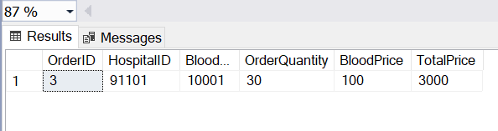
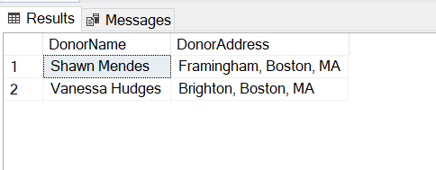
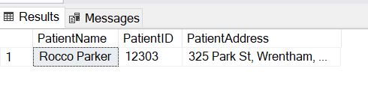
STORED PROCEDURES OUTPUT:

Slide 15
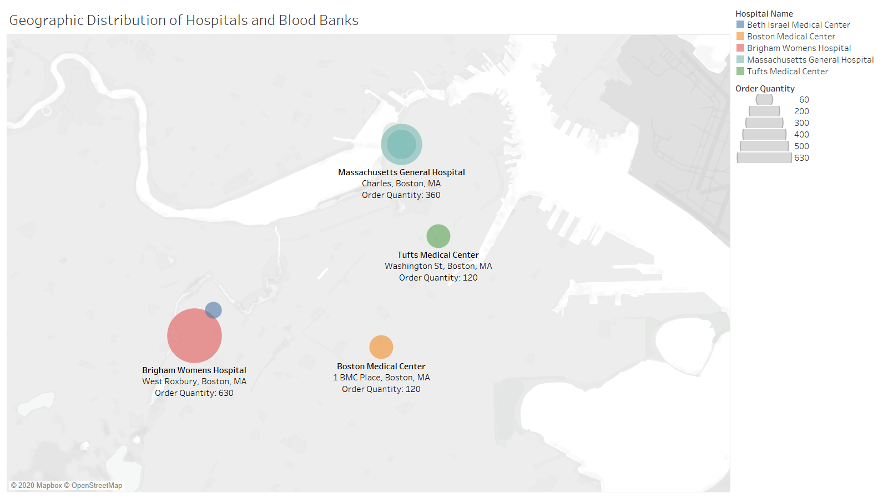
GEOGRAPHIC DISTRIBUTION OF HOSPITALS AND BLOOD BANKS

Slide 16
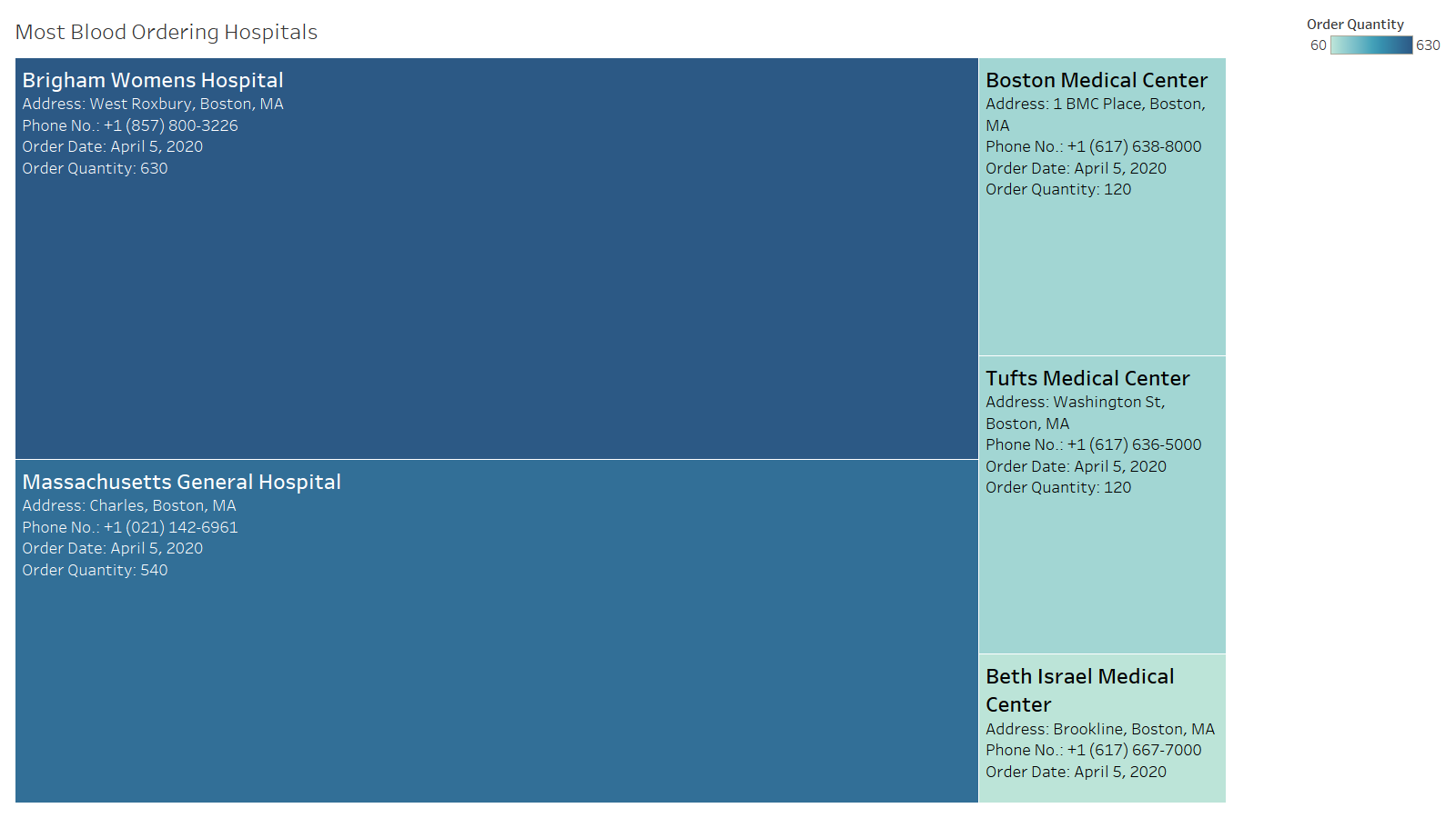
MOST BLOOD ORDERING HOSPITALS:

Slide 17
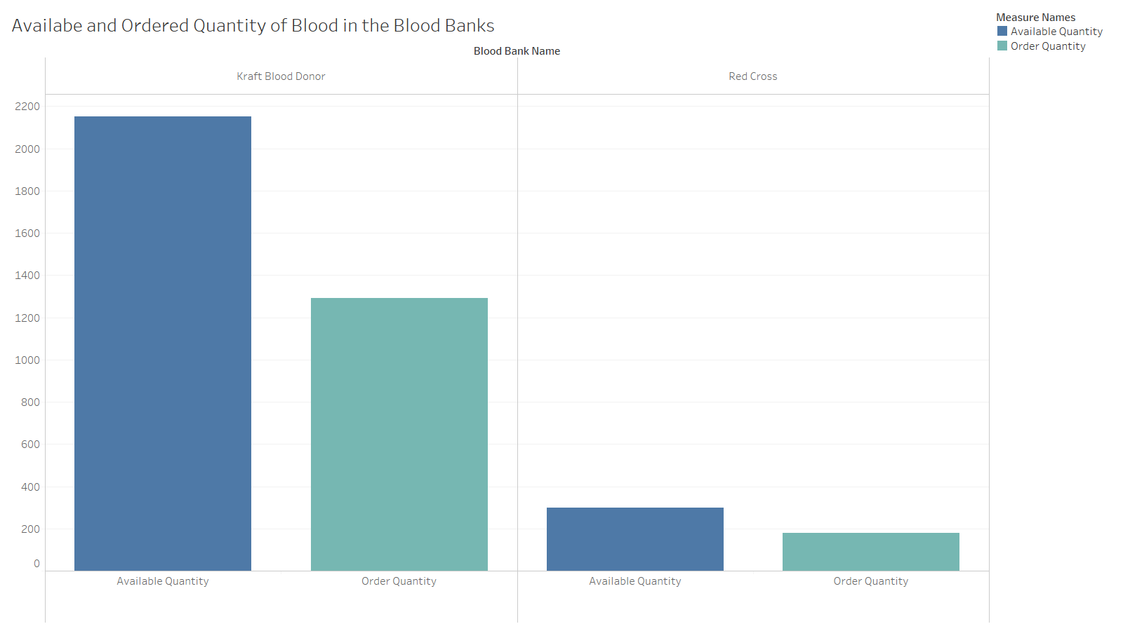
AVAILABLE AND ORDERED QUANTITY OF BLOOD IN THE BLOOD BANKS:

Slide 18
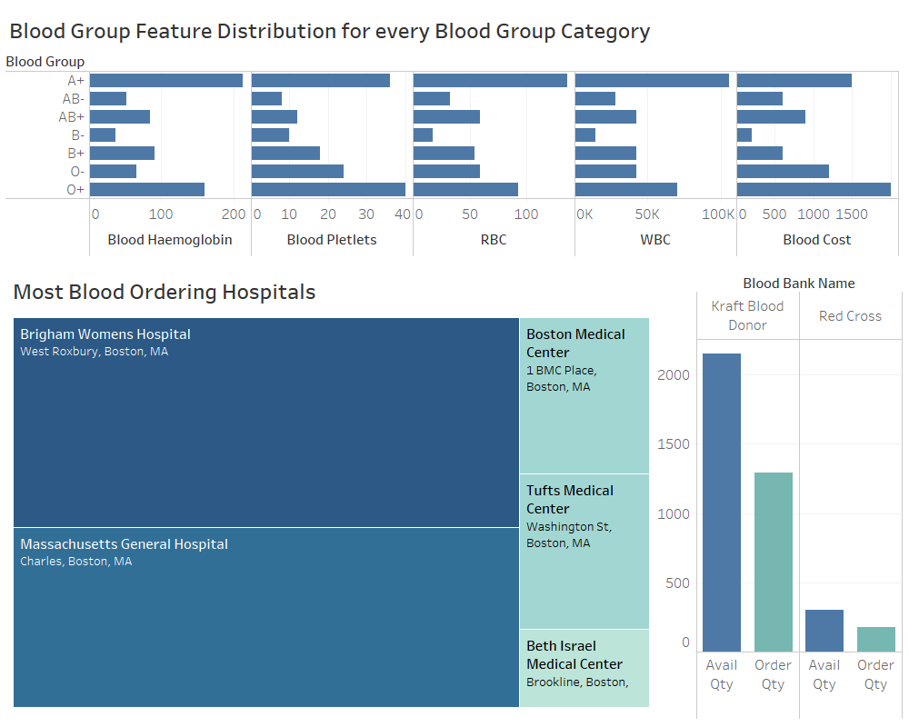
DASHBOARD:

Slide 19
THANK YOU!

